Slide 1
MyLegion.org
Manage Your Membership
American Legion
Sons of The American Legion
November 2022
Notes:
MyLegion is a secure website for American Legion and Sons of the American Legion members.

Slide 2
About MyLegion
Manage profile information. You can see the information that National Headquarters has on file, such as your address, and make updates.
Manage American Legion subscriptions. To e-newsletters, Dispatch and The American Legion Magazine.
Print membership card. You don't have to wait for a new membership card to arrive in the mail. By having access to your membership record through MyLegion.org, you can easily print a current membership card.
Renew membership. You can renew your membership online or set up automatic membership renewal. *Legion members only.
Notes:
Through MyLegion members can:
<1> Manage profile information. You can view your membership record and make updates and add missing information.
<2> Manage American Legion subscriptions to e-newsletters, Dispatch and The American Legion Magazine.
<3> Print membership card. You don't have to wait for a new membership card to arrive in the mail. By having access to your membership record through MyLegion.org, you can easily print a current membership card.
<4> Renew membership. Legion members can renew membership online or set up automatic membership renewal.

Slide 3
About MyLegion
View member-only discounts. American Legion members have access to veteran and military family discounts from retail to travel.
Find an American Legion accredited service officer. The Service Officer Directory in MyLegion.org provides access to accredited American Legion service officers who provide expert assistance, free of charge, to veterans and their families.
Officer Administrative Tools. Adjutants and Commanders have access to Post and squadron membership through their individual MyAccount log in. Administrative tools include member management, online membership processing, reports and officer publications. Create an individual member account and transition to the administrative side of MyLegion.
Notes:
MyLegion allows you to view member-only discounts. American Legion members have access to veteran and military family discounts from retail to travel.
<1> The Service Officer Directory in MyLegion.org provides access to service officers who provide expert assistance, free of charge, to veterans and their families.
<2> Through your individual account, adjutants and commanders can access post and squadron membership and officer administrative tools. Administrative tools include member management, online membership processing, reports and officer publications. Create an individual member account and transition to the administrative side of MyLegion.

Slide 4
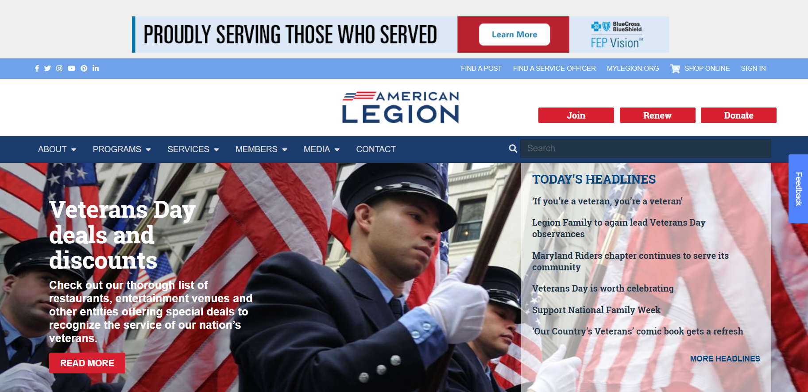
www.legion.org
Notes:
The American Legion National website is www.legion.org. The website provide department and national contacts, information on programs, services, and publications about The American Legion American Legion and The American Legion family. The log in for legion.org is the same for myLegion. Logging into either site provides member only information such as discount codes, subscriptions, registrations, training opportunities and other resources.
<1> Located at the top of the page is a link for MyLegion.

Slide 5
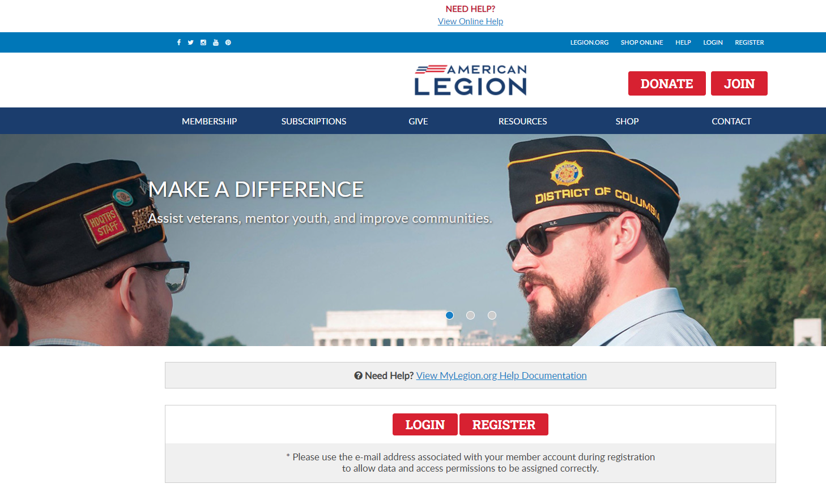
www.mylegion.org
Notes:
Log In. <1> at the upper right corner or using the login button below. <2>

Slide 6
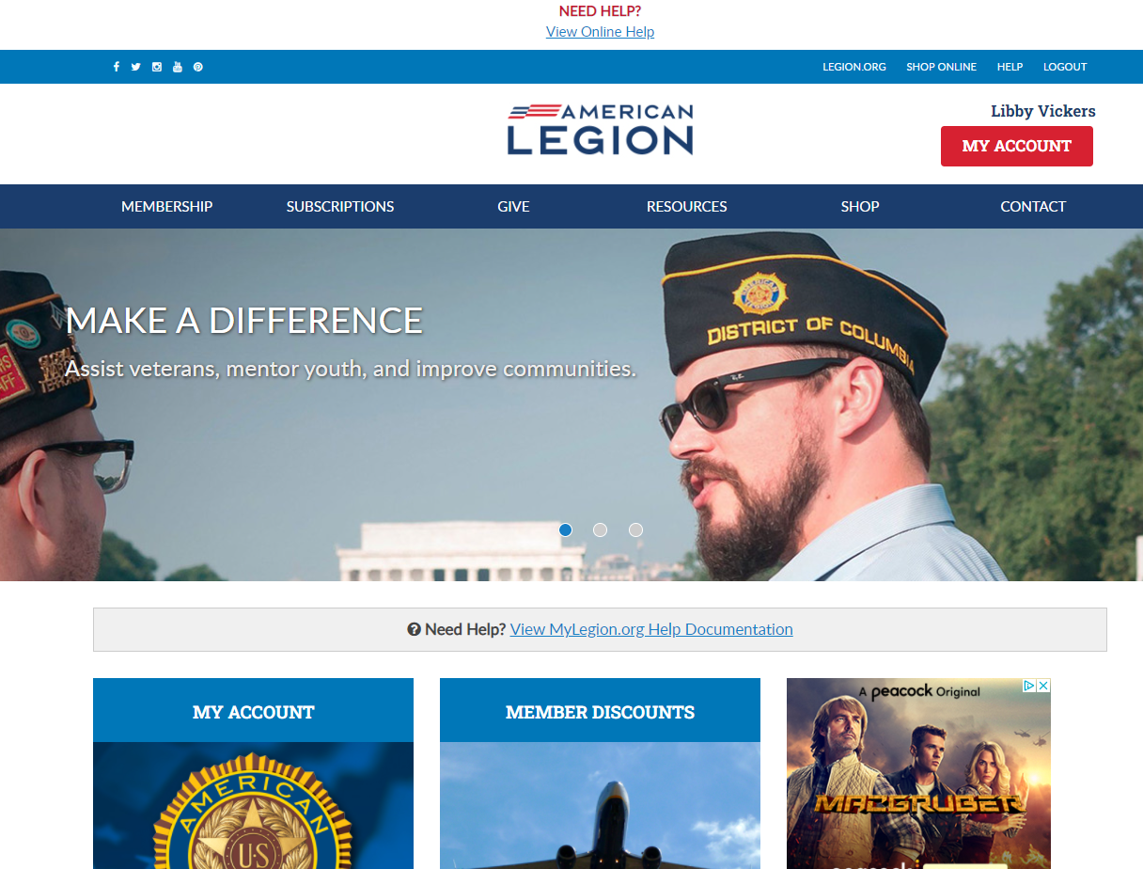
David Sample
Notes:
Logging into MyLegion opens the Home page. It identifies the member’s name located above the MY ACCOUNT button.

Slide 7
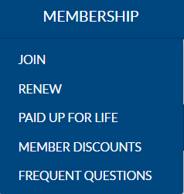
David Sample
Notes:
MyLegion provides links to Legion.org.
<1> Membership links include Join options, Renewal for members of The American Legion, Paid Up for Life information and links to purchase a paid up for life membership, along with Frequently asked questions about membership eligibility.

Slide 8
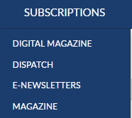
David Sample
Notes:
Membership in The American Legion includes The American Legion Magazine in digital format from the Subscriptions menu, a link to monthly Dispatch articles and set up options for online E-Newsletters. The Magazine option at the bottom of the list provides a link for non-members to purchase and renew their subscription or purchase additional subscriptions.

Slide 9
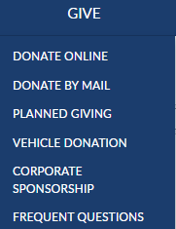
David Sample
Notes:
Online giving opportunities can be set up through a MyLegion account. The give menu provides information for planned giving, vehicle donations and corporate sponsorships. Questions about giving to American Legion charities are answered in frequent questions.

Slide 10
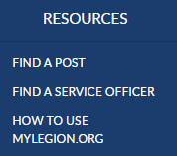
David Sample
Notes:
Resources helps you find a post or accredited service officers with step-by-step help documentation to assist with MyLegion tools for members and leadership.

Slide 11
David Sample
Notes:
The Shop link navigates to National Emblem Sales, and <1> Contact re-directs to legion.org’s National HQ directory.

Slide 12
David Sample
Notes:
Member only discount codes are located in MyLegion.org.

Slide 13
David Sample
Notes:
To view membership details and manage your account click on My Account. <1>
Leadership seeking post and squadron membership will access that information through My Account.

Slide 14
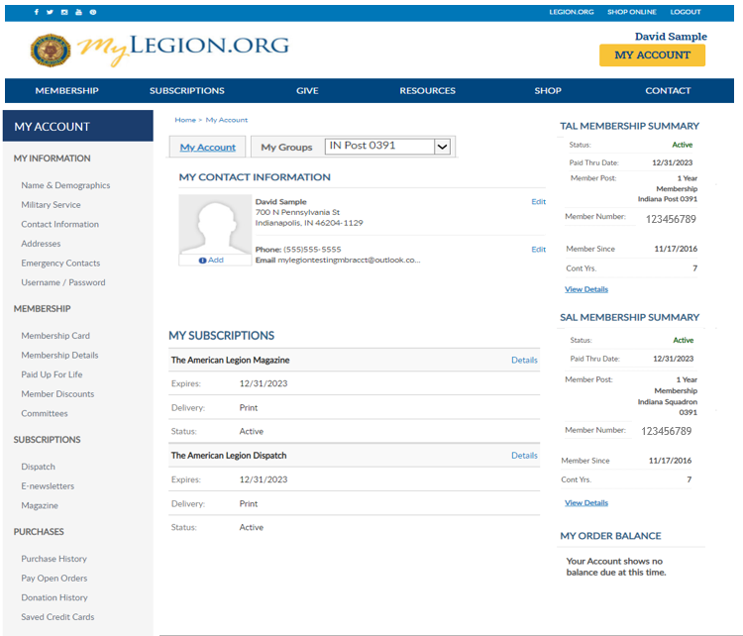
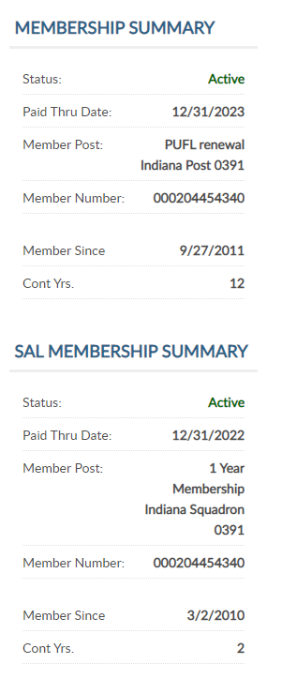
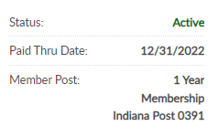
123456789
11
123456789
Notes:
My Account provide information on file at Department and National Headquarters.
<1>Summaries for American Legion and Sons of the American Legion membership displays. Member type is located in membership summary. Member post describes your payment type. <2> This member is a Paid Up For Life member.
<3> Members that renew membership will display as 1 year renewal. When membership is eligible for renewal, a balance will display in My Order Balance for renewal options.
Members of both Legion and SAL, also known as dual members, will have the same membership ID#.
<4> Adjutants and commanders will have a My Groups area. This area is restricted to adjutants, commanders, and group administrators. Learn more about My Groups in Resources online help.

Slide 15
Notes:
My contact information shows the primary address, phone number and email. Edit options to the right allow you to update. Name updates are only available from the left menu Name and Demographics option.
Members can add a photo to their membership record. Click the add link to add an image. This link also allows you to edit or delete. This image can be seen by your leadership, department and national headquarters.

Slide 16
Notes:
My subscriptions provides details about American Legion Magazine and Dispatch. This area is view only.

Slide 17
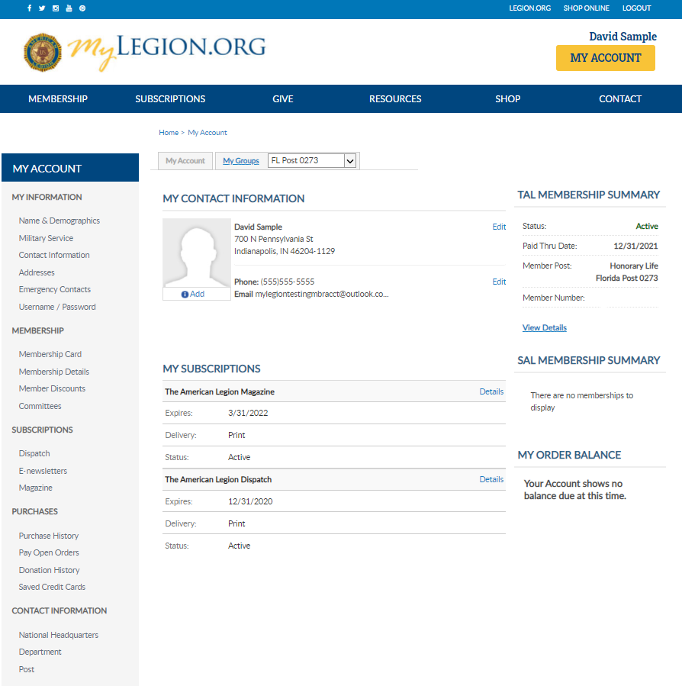
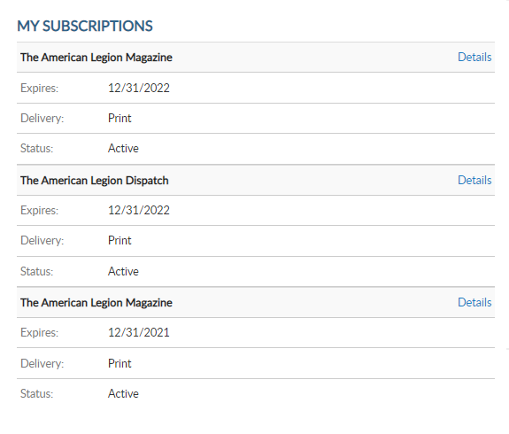
David Sample
123456789
123456789
Notes:
Additional resources are located in the My Account menu.
My Information includes all information on file at national headquarters.
<1> Name and Demographics lets you update your name,, including nickname, suffix, prefix and credentials. Demographics include date of birth, gender, and deceased status. After making updates in this section click Save.

Slide 18
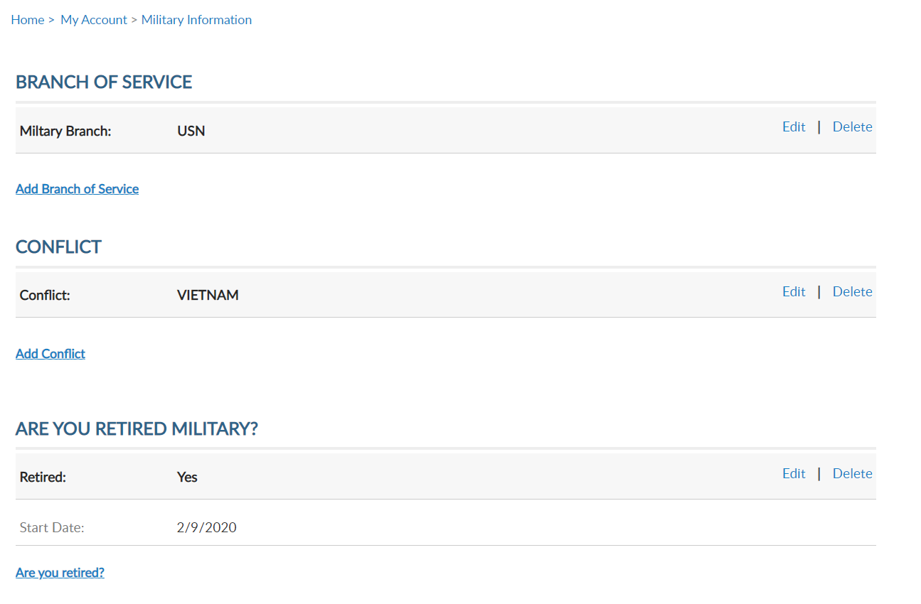
David Sample
123456789
123456789
Notes:
Military service provides branch of service, conflict and retirement information. More than one branch of service or conflict can be listed on your membership record. Using the Add, Edit or Delete links you can manage this information.

Slide 19
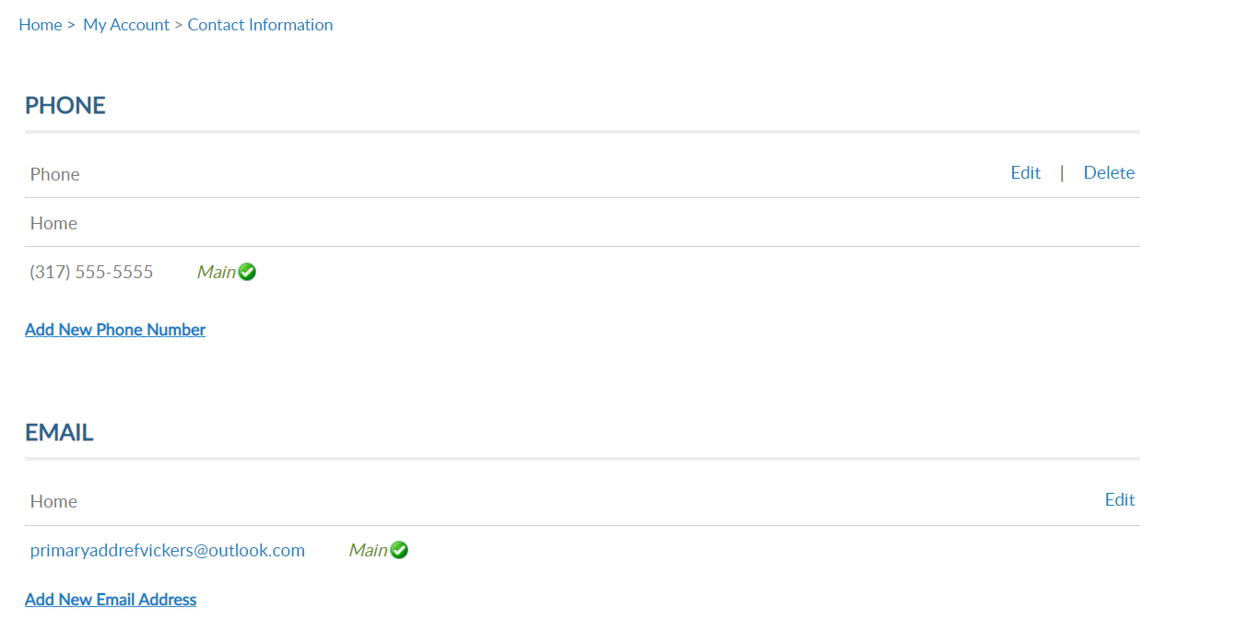
David Sample
123456789
123456789
Notes:
Contact information allows you to add, update and delete phone and email information.
The email set as “main email” is associated with your profile. The main email displays in MY CONTACT INFORMATION and Username/Password profile. It is also the email used for account username and password reset links.

Slide 20
David Sample
123456789
123456789
Notes:
Addresses allows you to add an alternate address and set address preferences. Information set as Main is the primary contact information. National HQs, Department HQs and other American Legion and Sons of the American Legion leadership use main contact information for mail, phone and email correspondence.
Only one main contact can be on file. Adding an address with the Main Address preference will replace the existing main address.
Addresses allows you to add an alternate address and set address preferences. Information set as Main is the primary contact information. National HQs, Department HQs and other American Legion and Sons of the American Legion leadership use main contact information for mail, phone and email correspondence.
Only one main contact can be on file. Adding an address with the Main Address preference will replace the existing main address.

Slide 21
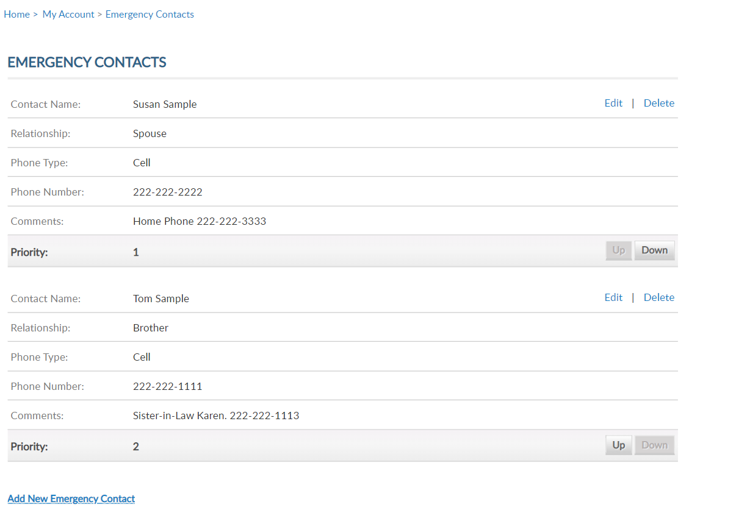
David Sample
123456789
123456789
Notes:
Emergency contact information. This information can be useful in case of an emergency if you are attending a convention, event, or at your local post.
Add a single contact or multiple contact and designate the priority of who to contact via phone.

Slide 22
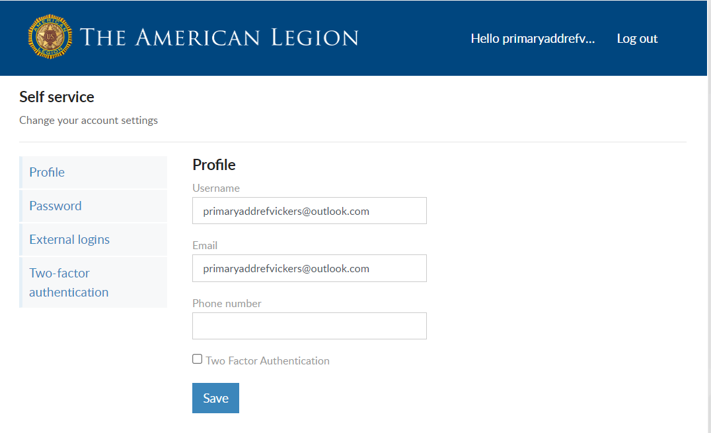
David Sample
123456789
123456789
Notes:
Username/Password allows you to update log in credentials. This link opens a self-service window that shows your current username and primary email associated with your account.
The username does not have to be an email address but is recommended. When updating a username, use a unique name that another member may use.
<1> The email address listed in the self-service window is the primary email on record and will update your contact information. Updating the email in Username/Password will directs all future forgot username and passwords to this email.
Enter new information and Save.

Slide 23
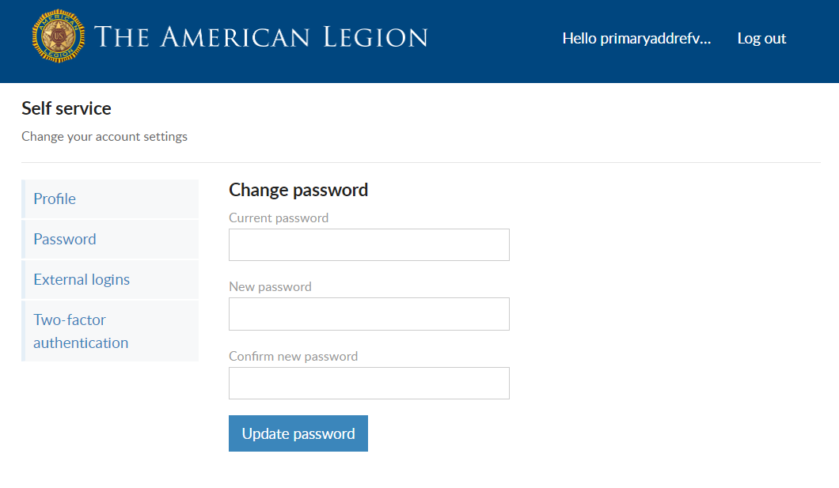
David Sample
123456789
Password Requirements:
1 Uppercase Letter
1 Lowercase Letter
1 Number
1 Symbol (!@#$%^&*)
8 character minimum
123456789
Notes:
To update your password in the self-service window you must know your current password. If you have logged in with a saved password and do not know it, you can log out and request a one-time password. This will email you a password reset link.
If you have your current password, enter it with the new password and click ‘Update Password’.
Password requirements include: 1 Uppercase letter, 1 Lowercase letter, 1 Number, 1 symbol, and have an eight character minimum.

Slide 24
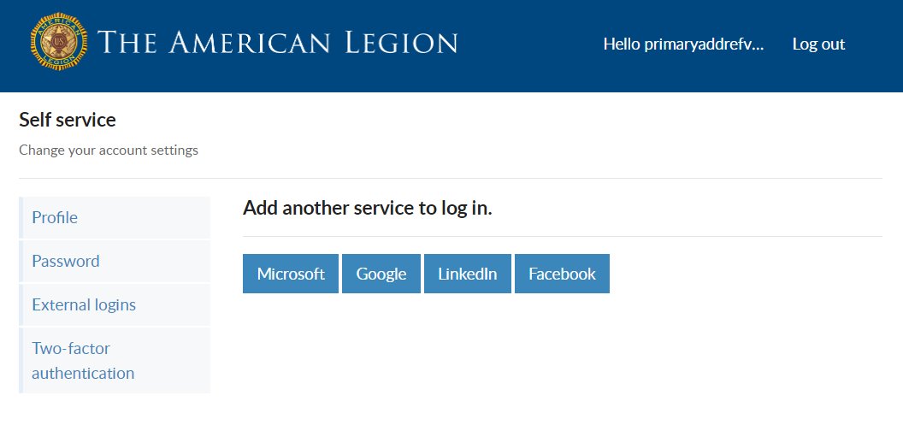
David Sample
123456789
123456789
Notes:
Like many other web applications, myLegion users can log in using other online identities as a single sign on process. Allowing fewer passwords to remember.

Slide 25
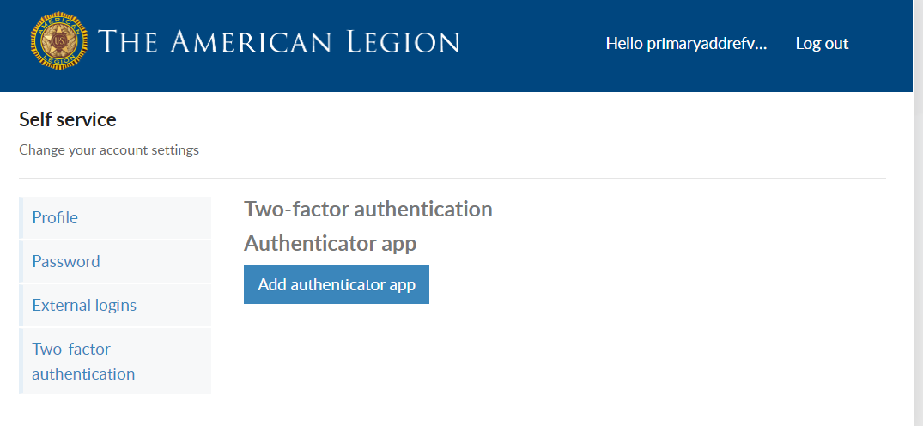
David Sample
123456789
123456789
Notes:
Two-factor authentication is an extra layer of security to ensure that you're the only person who can access your account, even if someone knows your password. This extra security measure requires you to verify your identity using a randomized code we'll send you each time you attempt to log in.
If you set up 2 factor authentication, you can disable through self service.

Slide 26
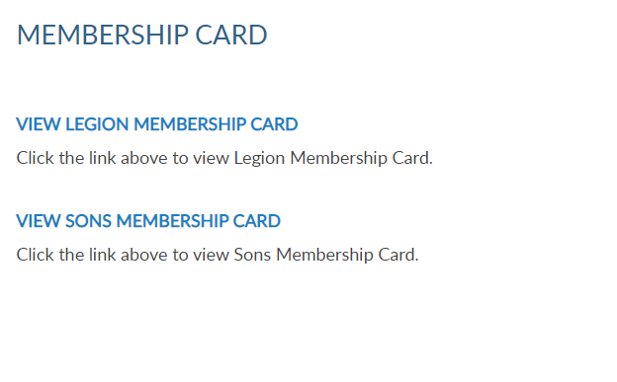
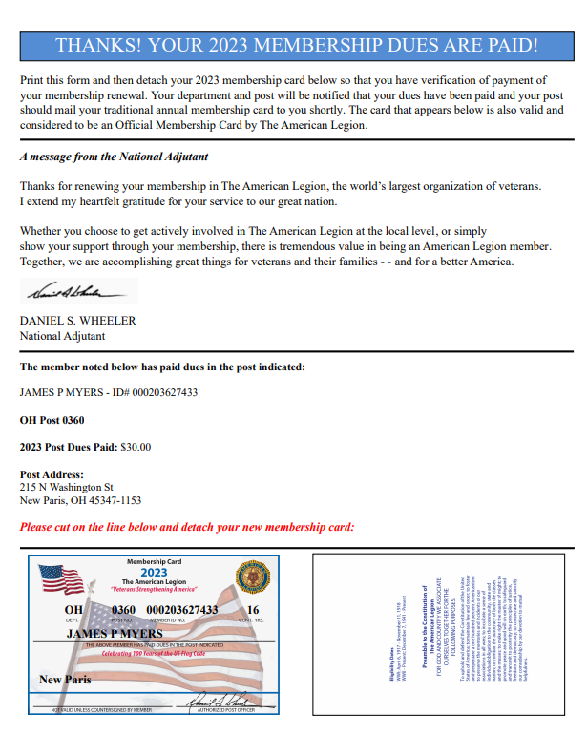
David Sample
123456789
Only current membership cards are available through MyLegion.
123456789
Notes:
The membership area lets members print their membership cards.
If a member is a dual member, both Legion and SAL cards can be printed.
<1> Only current membership cards are available. If you do not have a link to print your card, you first need to pay current dues. Once dues are paid, the card is available to print.
<2> Click the blue link. This opens a PDF document to print with a payment receipt and membership card signed by the National Adjutant. Members can take this card to the post for the adjutant’s signature.

Slide 27
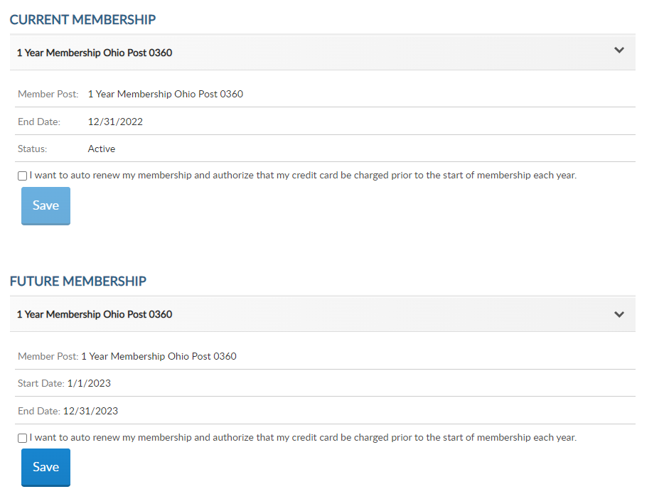
David Sample
1 Year Membership Indiana Post 0391
1 Year Membership Indiana Post 0391
123456789
1 Year Membership Indiana Post 0391
1 Year Membership Indiana Post 0391
123456789
Notes:
In membership details members can view current memberships and future memberships. The member detail includes your post or squadron state and number, membership end date, and current status.
Membership details has a checkbox to add auto renew the beginning of each membership year. <1>
Members set up for auto renewal will have their credit cards charged by the 2nd week of July annually. The American Legion’s membership campaign runs from July 1 – June 30.

Slide 28
David Sample
1 Year Membership Indiana Post 0391
1 Year Membership Indiana Post 0391
123456789
1 Year Membership Indiana Post 0391
1 Year Membership Indiana Post 0391
123456789
Notes:
Checking the box gives you a link to set up your credit card information if you do not already have one saved.
Select the link to provide credit card information. <1>

Slide 29
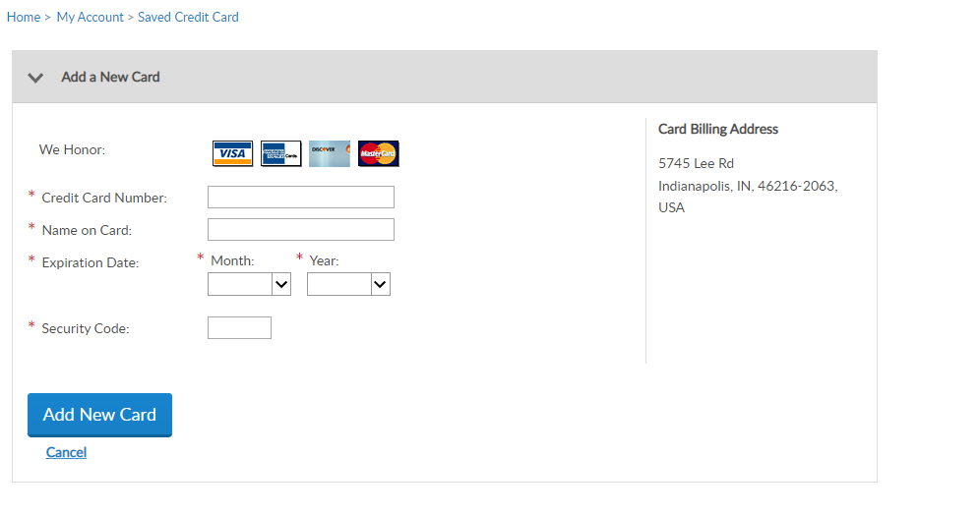
David Sample
123456789
123456789
Notes:
Enter your credit card information and “Add New Card”. The billing address must be the same as the billing address recorded on your membership record. To update the billing address return to Addresses.

Slide 30
David Sample
1 Year Membership Indiana Post 0391
1 Year Membership Indiana Post 0391
123456789
1 Year Membership Indiana Post 0391
1 Year Membership Indiana Post 0391
123456789
Notes:
Return to member details and re-check the box now that credit card information has been entered and click Save.

Slide 31
David Sample
1 Year Membership Indiana Post 0391
1 Year Membership Indiana Post 0391
123456789
1 Year Membership Indiana Post 0391
1 Year Membership Indiana Post 0391
123456789
Notes:
Members can manage auto renewals. Uncheck the box to remove auto renewal and click Save.
Updates to credit card information can be done by clicking <1> My Saved Credit Cards or <2> Saved Credit Cards in purchases.

Slide 32
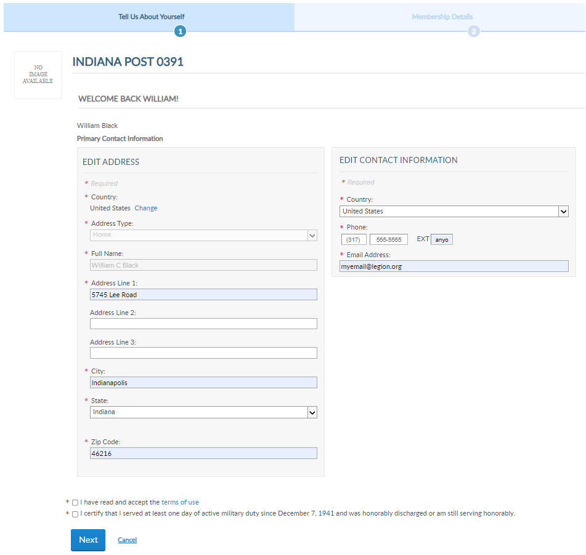
David Sample
WELCOME BACK DAVID!
123456789
123456789
Notes:
The Paid Up For Life links provide the application to purchase a paid up for life membership. The application provides a quote to purchase, set up a time payment plan or purchase in full.

Slide 33
David Sample
123456789
123456789
Notes:
The American Legion offers exclusive discount programs for members of The American Legion and Sons of the American Legion. Discount provider information and codes are only available in myLegion.org member accounts.
Discount codes are found only when logged into myLegion. Select the area of interest to view provider contact information and exclusive discount codes.

Slide 34
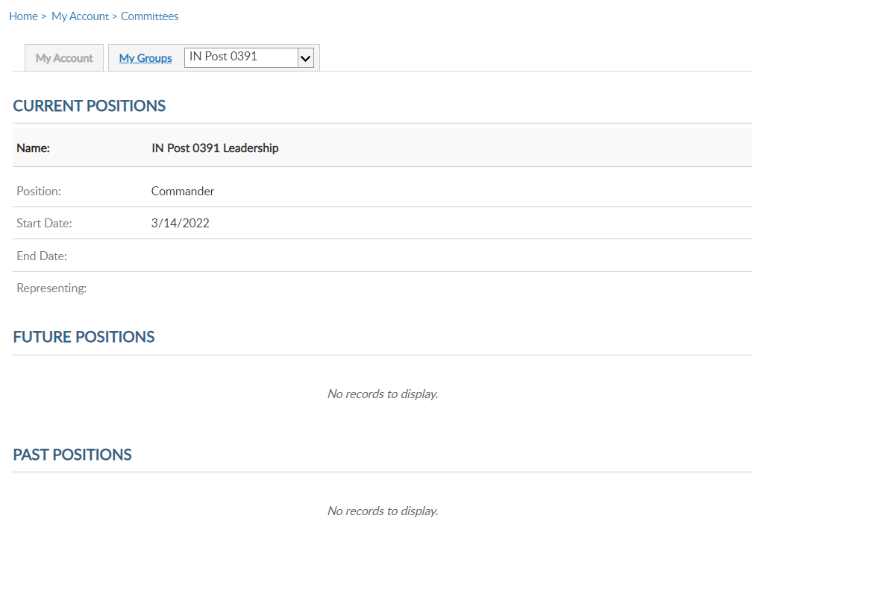
David Sample
123456789
123456789
Notes:
Committees list current, future and past positions reported to national headquarters. Missing information regarding your officer history can be clarified through your department headquarters.

Slide 35
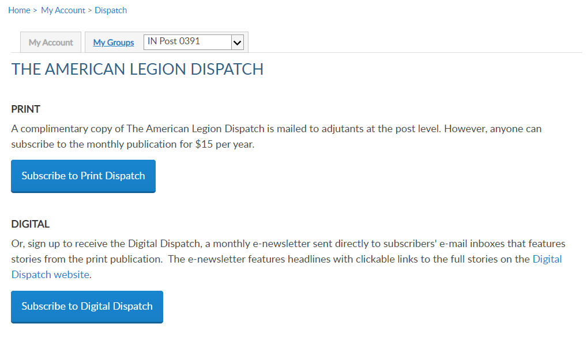
David Sample
123456789
123456789
Effective January 2023, The American Legion Dispatch goes to a digital-only format.
Notes:
Dispatch is an American Legion National Headquarters monthly online newsletter that provides post, district and department leaders with news relevant to membership, post activities and national American Legion news.
A monthly Digital Dispatch e-newsletter is sent directly to subscribers’ email inboxes. The e-newsletter features headlines with clickable links to the full stories on the Digital Dispatch web page, www.legion.org/dispatch.

Slide 36
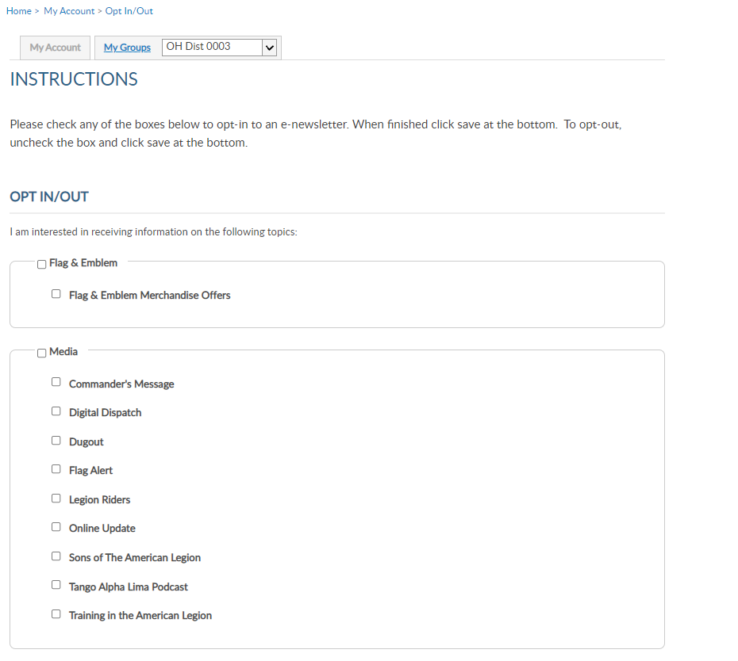
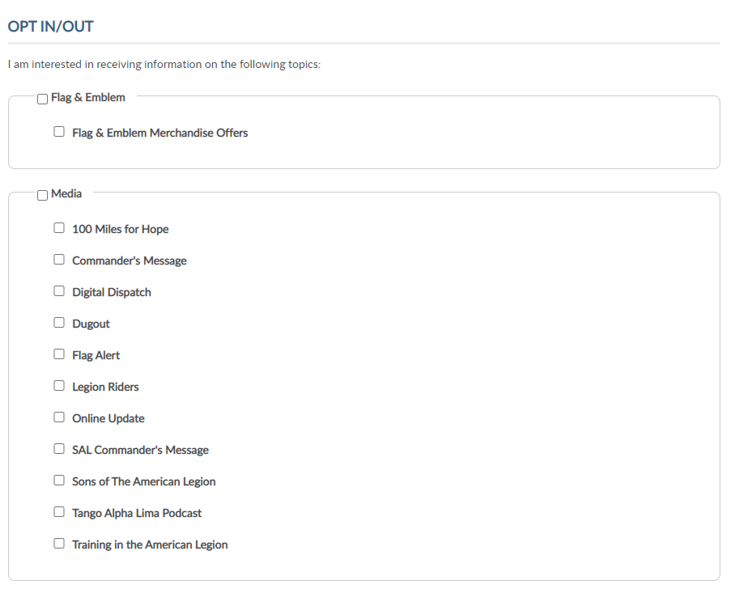
David Sample
123456789
123456789
Notes:
E-newsletters allows you to opt in or out of online subscriptions.
Check the box to select individual subscriptions. Unless specified these subscriptions will be emailed to the main email address on file.
<1> Once all options are selected, save changes.

Slide 37
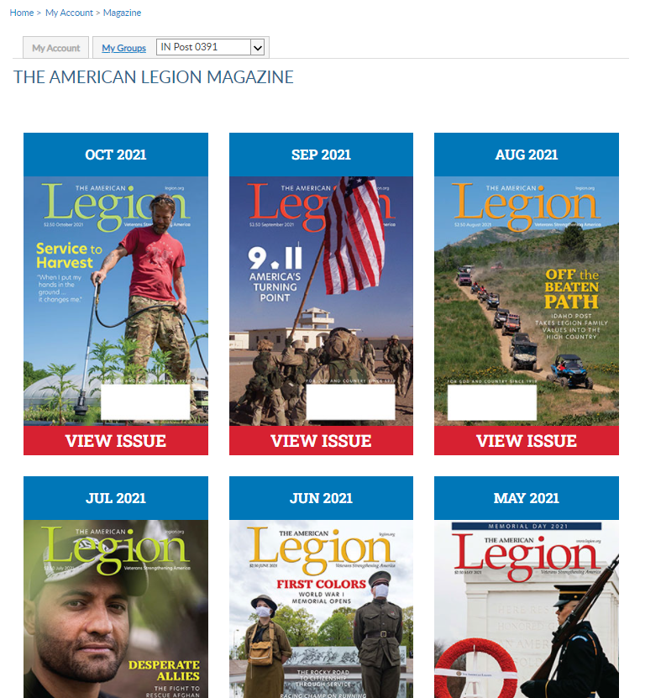
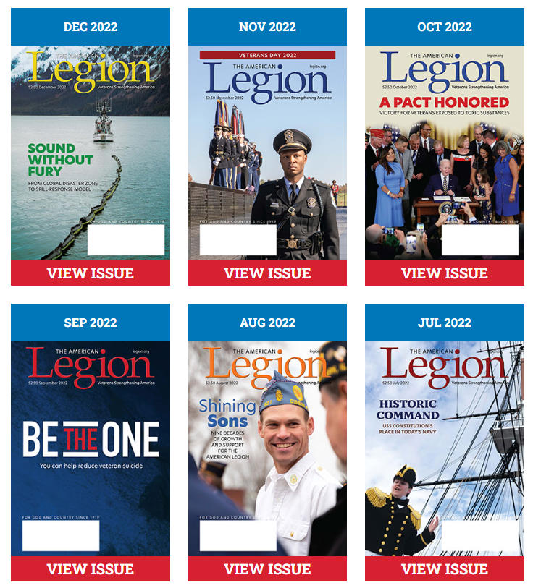
David Sample
123456789
123456789
Notes:
Members receive a 12-month free subscription to The American Legion Magazine. This publication has gone digital. Current and past issues are located your My Account subscriptions menu.
Expired members will receive an Access Denied message. Access to online magazine requires active American Legion, Sons of the American Legion membership, or paid subscription.

Slide 38
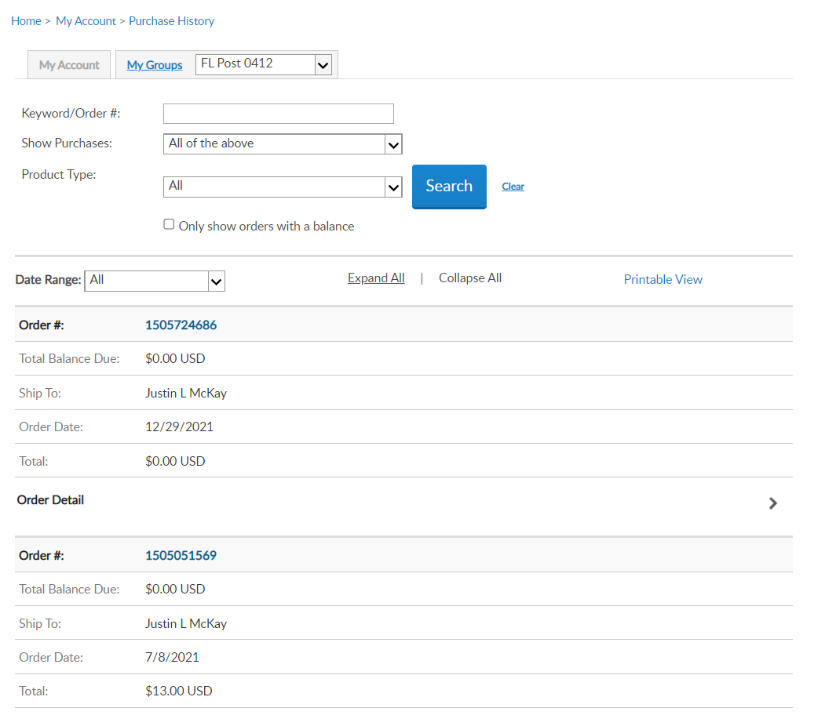
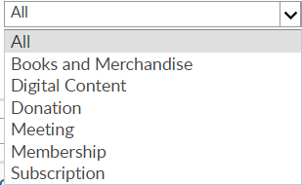
David Sample
123456789
David Sample
123456789
David Sample
Notes:
The purchase history shows history of payments made for membership, donations and subscriptions listing the amount and date.
<1> Filtering menus allow you to view information based on the type of purchase and date range.

Slide 39
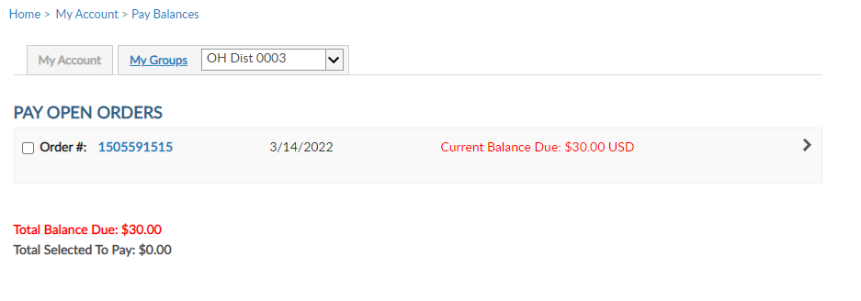
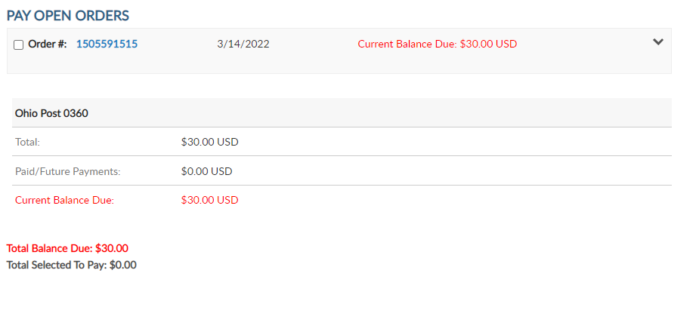
David Sample
123456789
123456789
Notes:
Pay Open Orders is the same as what displays in MY ORDER BALANCE. The amount due includes post dues for your renewal. Online renewal for Squadron members is not available. National is in the process of collecting data to activate this feature in the future.
Clicking on the down arrow <1> expands more detail. <2>

Slide 40
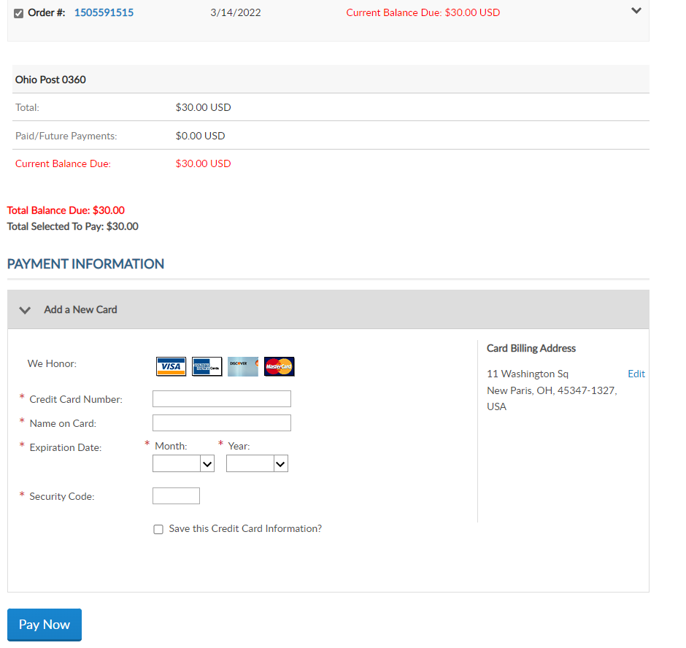
David Sample
123456789
123456789
5745 Lee Road
Indianapolis, IN 46216
Notes:
Continue to payment by checking the order box. <1>
This will allow you to add payment information. <2>

Slide 41
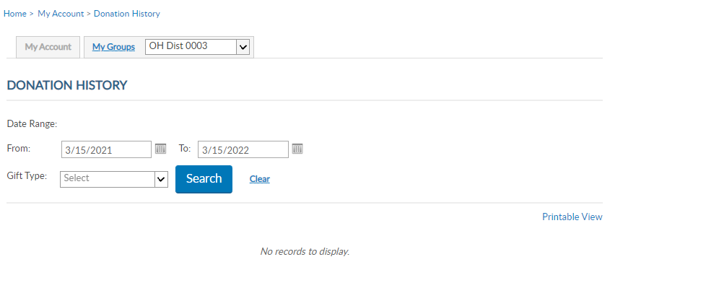
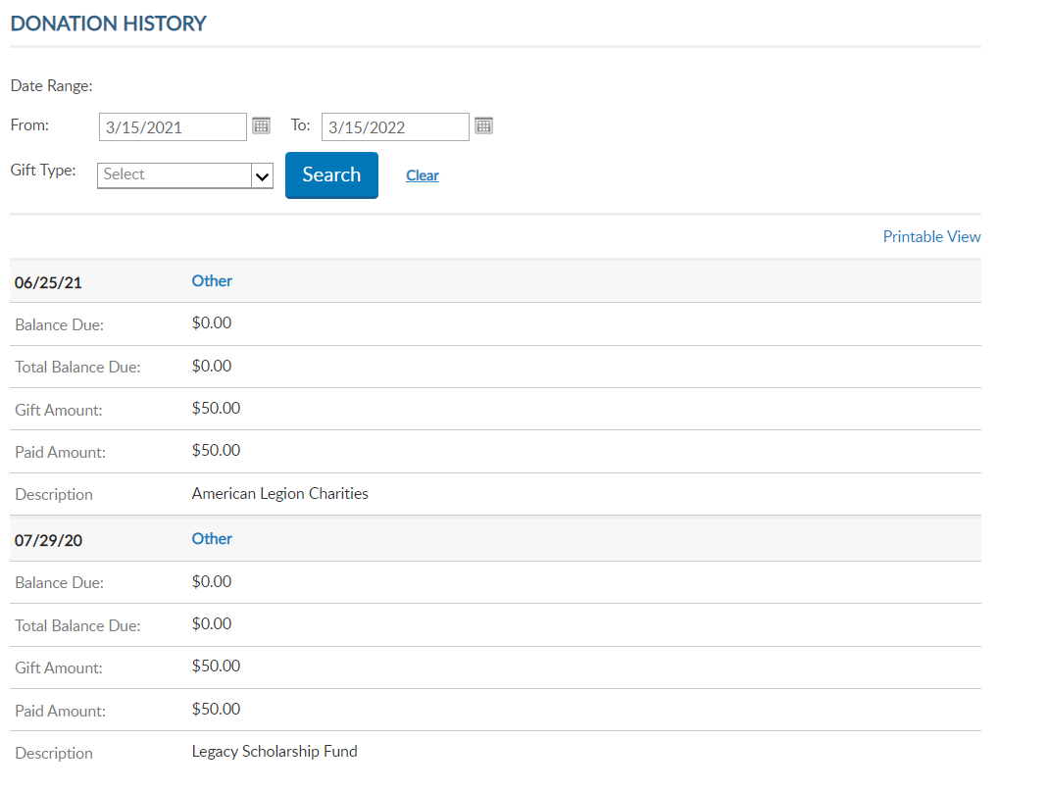
David Sample
123456789
123456789
Notes:
Donation history records all online and mailed in giving. A date range search assists as you review your giving to American Legion programs and charities.

Slide 42
David Sample
1234
David Sample
5745 Lee Road
Indianapolis, IN 46216
123456789
123456789
Notes:
Credit card information can be maintained through myLegion in the Saved Cred Card area. Add, update or remove the credit card when needed.
Updating credit card billing address will update the primary email address on your membership record.

Slide 43
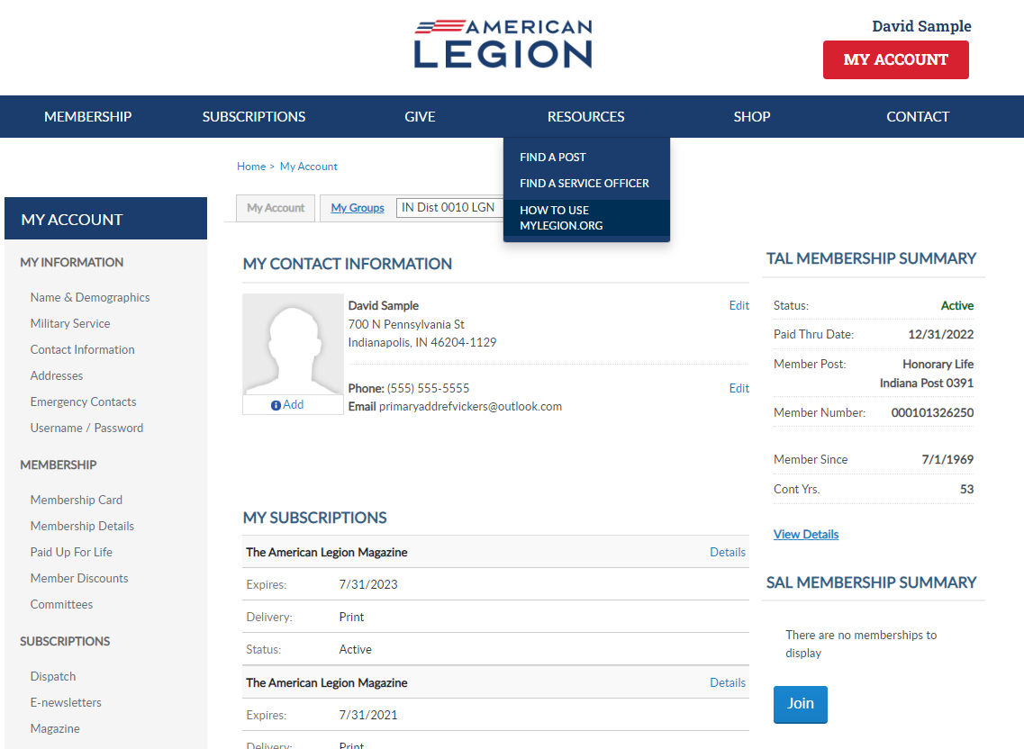
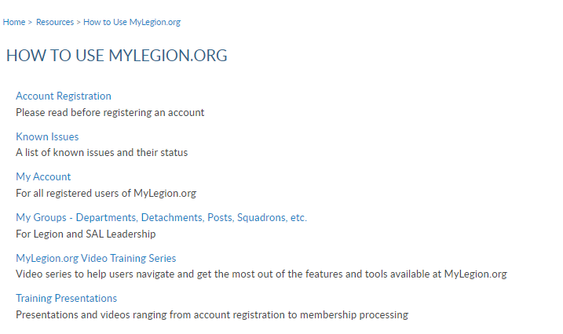
12/31/2023
123456789
Notes:
<1> Step by step instructions for both member management and officer tools are located in this area.

Slide 44
Email:
mylegion@legion.org
Phone:
800.433.3318
Notes:
Your National support staff is available Monday through Friday, 8-4:30pm Eastern.
11/30/22 – Updated Digital Dispatch page. No longer in print copy beginning Jan 2023.

